Slide 1
Instructions
If desired, move the daily double slides (right before any "answer" slides), also changing the hyperlinks from the boards.
Audio is embedded on host slide.
Run the show. It begins on the host slide. Host and category headings are timed slides.
Click on unvisited dollar values on the board to reveal "answers.“
If a daily double shows up, wait for the wager and then advance the show.
After contestant responds, reveal a correct "question" by advancing the show.
Click anywhere on "question" slides to return to the board OR mouse over “Jeopardy” to go to score card.
On score card mouse over “game board” to return to the board.
For Final Jeopardy, reveal the category, wait for wagers, and then advance the show.
DO NOT SAVE changes when closing! This allows the hyperlinks to reset.

Slide 2



Slide 3

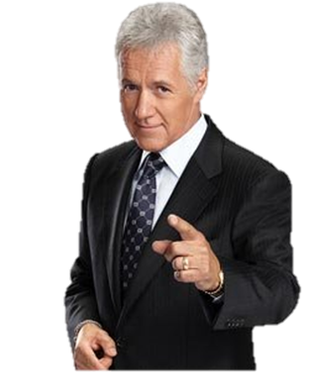


Slide 4
Body Mechanics

Slide 5
3-2-1 Connection
Notes:
Connect/Disconnect an Implement (trailed, 3 point, power take off (PTO), hydraulics)

Slide 6
Gotta Get Fed

Slide 7
Feeding the Babies

Slide 8
Outstanding in My Field

Slide 9
Stand T.A.L.L.

Slide 10

Bending, Lifting, Climbing
3-2-1 Connect
Gotta get Fed
Feeding the Babies
Outstanding in my Field
Stand T.A.L.L
$100
$100
$100
$100
$100
$100
$200
$200
$200
$200
$200
$200
$300
$300
$300
$300
$300
$300
$400
$400
$400
$400
$400
$400
$500
$500
$500
$500
$500
$500

Slide 11
What should you do frequently when lifting a lot?
Notes:
100 Bending Lifting Climbing

Slide 12
Breaks or stretching
Notes:
100 Bending Lifting Climbing

Slide 13
What body part should you use when lifting?
Notes:
200 Bending Lifting Climbing

Slide 14
Legs
Notes:
200 Bending Lifting Climbing

Slide 15
How many points of contact are maintained when climbing a ladder properly?
Notes:
300 Bending Lifting Climbing

Slide 16
3
Notes:
300 Bending Lifting Climbing

Slide 17
How many minutes should a 10 year old work between breaks?
Notes:
400 Bending Lifting Climbing

Slide 18
20 minutes
Notes:
400 Bending Lifting Climbing

Slide 19
What is the maximum height that youth under 16 should climb?
Notes:
Make this 300 level
500 Bending Lifting Climbing

Slide 20
20 feet
Notes:
500 Bending Lifting Climbing

Slide 21
What type of clothing should not be worn around PTOs?
Notes:
100 3-2-1 Connect

Slide 22
Loose fitting clothes or clothes with strings
Notes:
100 3-2-1 Connect

Slide 23
What is a common hazard when working with PTOs?
Notes:
200 3-2-1 Connect

Slide 24
Entanglement, weight or pinch point
Notes:
200 3-2-1 Connect

Slide 25
What is the most dangerous hazard when working with hydraulics?
Notes:
300 3-2-1 Connect

Slide 26
Ruptured hose (chemical injuries)
Notes:
300 3-2-1 Connect

Slide 27
How many steps should you be able to repeat before working with implements?
Notes:
400 3-2-1 Connect

Slide 28
10
Notes:
400 3-2-1 Connect

Slide 29
How many times should you demonstrate a job before doing it alone?
Notes:
500 3-2-1 Connect

Slide 30
4-5
Notes:
500 3-2-1 Connect

Slide 31
Why is it important to be comfortable with animals when feeding them?
Notes:
100 Gotta Get Fed

Slide 32
Animals pick up fear, less likely to get injured, etc.
Notes:
100 Gotta Get Fed

Slide 33
What type of route must you have when working with animals?
Notes:
200 Gotta Get Fed

Slide 34
Escape
Notes:
200 Gotta Get Fed

Slide 35
Cell phones and walkie-talkies are examples of what type of communication?
Notes:
300 Gotta Get Fed

Slide 36
Two-way communication
Notes:
300 Gotta Get Fed

Slide 37
What is an infectious disease transmitted from animals to humans?
Notes:
400 Gotta Get Fed

Slide 38
Zoonotic disease
Notes:
400 Gotta Get Fed

Slide 39
Daily
Double!

Slide 40
How much can a young worker safely lift?
(express in % of body weight)
Notes:
500 Gotta Get Fed

Slide 41
25%
Notes:
500 Gotta Get Fed

Slide 42
What are common hazards encountered when feeding calves?
Notes:
100 Feeding the Babies

Slide 43
Weight, animal contact, slippery surface, chemicals, or burns
Notes:
100 Feeding the Babies

Slide 44
If youth is showing signs of strain when carrying feed, what should they do?
Notes:
200 Feeding the Babies

Slide 45
Have an adult carry it, use a cart, etc.
Notes:
200 Feeding the Babies

Slide 46
When feeding calves, when would chemicals be a hazard?
Notes:
300 Feeding the Babies

Slide 47
Cleaning
Notes:
300 Feeding the Babies

Slide 48
After feeding milk to calves and cleaning up, what should you do?
Notes:
400 Feeding the Babies

Slide 49
Wash hands and change outer clothing
Notes:
400 Feeding the Babies

Slide 50
What are three types of PPE you would need when feeding milk to calves?
Notes:
500 Feeding the Babies

Slide 51
Steel toed shoes, eye protection, gloves, dust mask or handwashing
Notes:
500 Feeding the Babies

Slide 52
What should an adult do with a youth before allowing them to use implements?
Notes:
100 Outstanding in my Field Need to do this and down

Slide 53
Training
(e.g. tractor safety class)
Notes:
100 Outstanding in my Field

Slide 54
What does PTO stand for?
Notes:
200 Outstanding in my Field

Slide 55
Power Take Off
Notes:
200 Outstanding in my Field

Slide 56
What are three distractions when doing fieldwork with an implement?
Notes:
300 Outstanding in my Field

Slide 57
Cell phone, radio, extra riders, bystanders, animals, etc.
Notes:
300 Outstanding in my Field

Slide 58
Daily
Double!!

Slide 59
What is peripheral vision?
Notes:
400 Outstanding in my Field

Slide 60
Seeing out the sides while looking forward
Notes:
400 Outstanding in my Field

Slide 61
What should youth do when equipment malfunctions?
Notes:
500 Outstanding in my Field

Slide 62
Shut it down and call an adult
Notes:
500 Outstanding in my Field

Slide 63
What should you do if unsure of how to do a task?
Notes:
100 Stand T.A.L.L.

Slide 64
Ask questions
Notes:
100 Stand T.A.L.L.

Slide 65
Who should train a youth?
Notes:
200 Stand T.A.L.L.

Slide 66
An adult who understands the job and hazards
Notes:
200 Stand T.A.L.L.

Slide 67
What is a hazard?
Notes:
300 Stand T.A.L.L.

Slide 68
Something with the potential to cause injury or death
Notes:
300 Stand T.A.L.L.

Slide 69
What should a worker do if they feel unsafe?
Notes:
400 Stand T.A.L.L.

Slide 70
Refuse to do the job
Notes:
400 Stand T.A.L.L.

Slide 71
By law, what is an employee right?
Notes:
500 Stand T.A.L.L.

Slide 72
Fair pay, safe working conditions, report unsafe conditions w/o retaliation
Notes:
500 Stand T.A.L.L.

Slide 73
Final
Jeopardy!!

Slide 74
Employee Rights

Slide 75
Report unsafe and/or unhealthy work conditions without retaliation.

Slide 76
What is whistleblower?

Slide 78

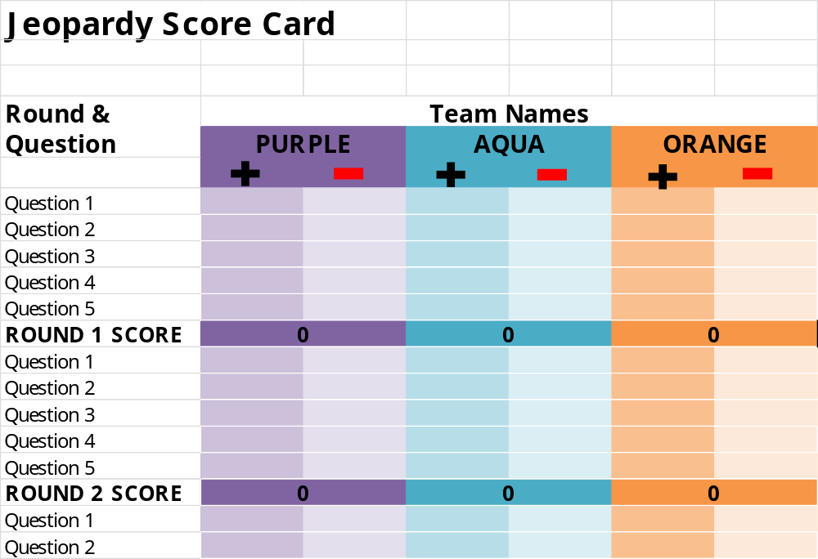
Game Board

